Slide 2
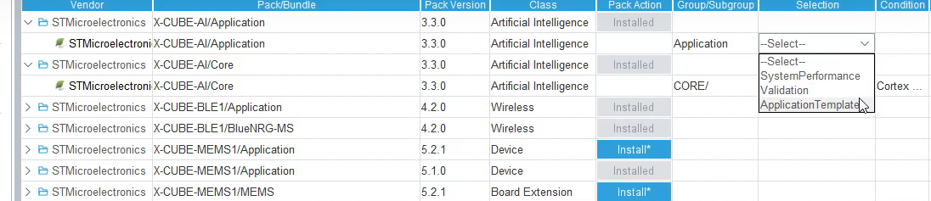
Three modes are provided in application
System Performance: benchmark the neural network implementation on the target
Validation: benchmark & compare the results
Application Templates: build the user application on the top of this template

